Slide 1

Hypothesis testing and multiple populations
Dr Lee Barnby
School of Computing
7MA505 Statistical Techniques
Week 3, Autumn Semester

Slide 2
Outline
Confidence Intervals
  When σ is unknown
  For 2 populations
Hypothesis testing
  Single populations
  Two-sample inference
  Paired data

Slide 3
Confidence Interval when σ is unknown
Almost always the case that σ is unknown and must be estimated using the sample standard deviation s
The value 1.96 in the (95%) confidence interval is replaced by a new quantity, denoted t_{0.025}
The 95% confidence interval for an unknown σ is
  x̅ ± t_{0.025} x s/√n

Slide 4
Student’s t Distribution
William Sealy Gosset published this distribution in 1908. He was working in Guinness’s brewery in Dublin. He published with the pseudonym, Student.
Closely related to the standard normal distribution Z
  Symmetric and bell-shaped
  Has a mean = 0 but has a larger standard deviation
Exact shape depends on a parameter called degrees of freedom (df) which is related to the sample size
  In this context df = n - 1

Slide 5
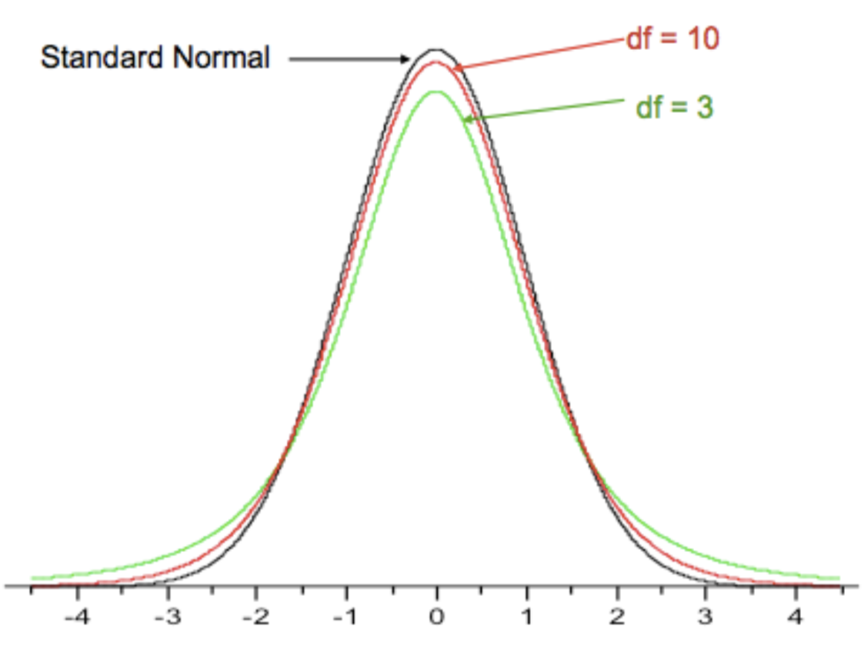
Comparing Normal and t distributions

Slide 6
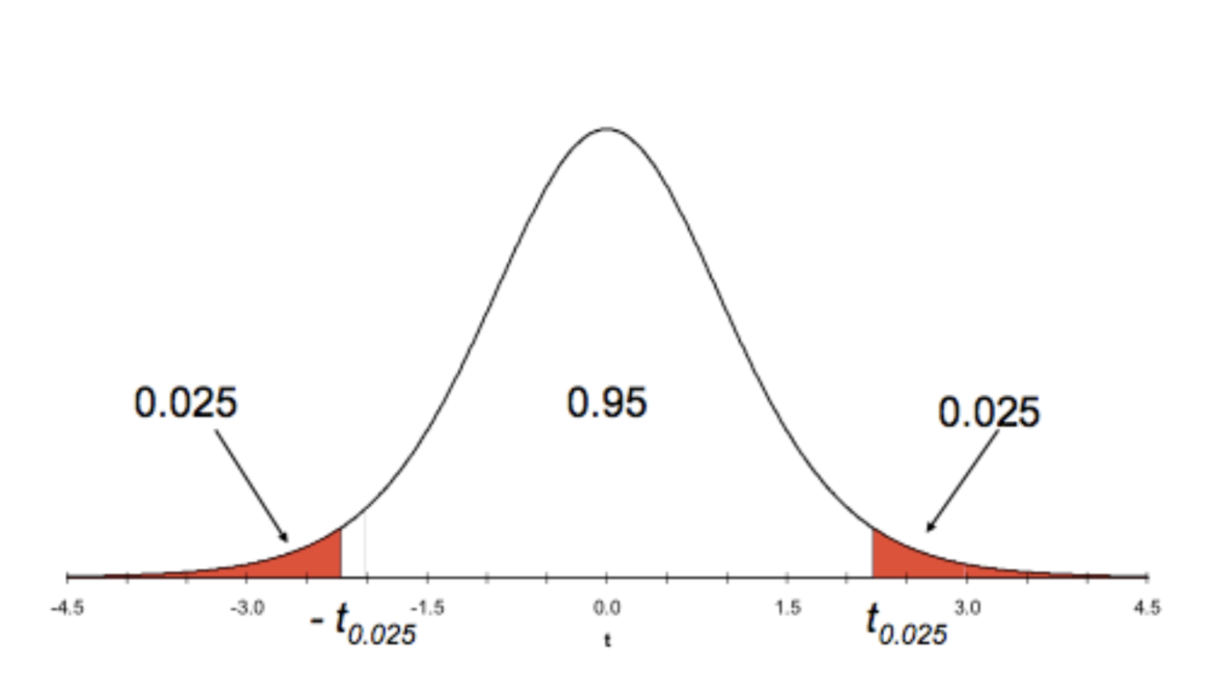
Definition of t_{0.025} values

Slide 7
Example
498.38 | 489.31 | 450.40 | 495.24 | 490.17 | 483.20 | 488.47 | 497.71 | 503.41
482.25 | 488.14 | 492.22 | 483.96 | 473.93 | 463.40 | 493.65 | 499.48 | 496.05
494.54 | 508.58 | 488.42 | 463.68 | 492.46 | 489.45 | 491.57 | 489.33
26 measurements of the potency of a single batch of tablets in mg
x̅ = 490.96, s = 10.783 mg per tablet
t_{0.025} for df = 25 is 2.06
So x̅ ± t_{0.025} × s/√n = 490.096 ± 2.06 × 10.783/√26
= 490.096 ± 4.356
Batch potency lies between 485.74 and 494.45 mg per tablet.
Value can be generated in R with:
>qt(0.025, 25)
-2.059539

Slide 8


Confidence intervals for 2 populations
If we have two independent variables x₁ and x₂ which are normally distributed:
Then, for a linear combination ax₁ + bx₂
Eqn 3.1

Slide 9
Example 2-population calculation
A task-based work study measured the time that a random sample of 40 employees under the age of 35 took to complete a job and a random sample of 36 employees over that age
Results were:
  Under 35 – mean time = 51 minutes,
  population standard deviation = 5 minutes
  Over 35 - mean time 48 minutes,
  population standard deviation = 7 minutes
Calculate a 98% confidence level for the difference between the average time taken by the two groups
For simplicity we will assume that we could measure σ !

Slide 10
Example 2-population calculation cont.
Look back to linear combination equation, set a = 1, b = -1
  Mean is aµ₁ + bµ₂ = 51 - 48 = 3 minutes
  Population variance is
  a²σ²₁/n₁ + b²σ²₂/n₂ = 5²/40 + 7²/36 = 0.625 + 1.36111 = 1.98611 minutes²
Require 98% confidence level so α/2 = 1% = 0.01
Can be solved with function in R
  qnorm(0.01, mean=3, sd=sqrt(1.986111))
  qnorm(0.99, mean=3, sd=sqrt(1.986111))
Interval containing mean of the difference, at the 98% confidence level, is
(-0.27851, 6.27851) minutes

Slide 11
Hypothesis testing

Slide 12
Hypothesis testing - introduction
Want to test validity of a claim about a population characteristic
For example,
  Mean potency, µ, of a batch of 26 tablets is 500 mg per tablet
  µ₀ = 500 mg
Thus, the null hypothesis is H₀ : µ₀ = 500

Slide 13
Hypothesis testing - procedure
Specify the null and alternative hypotheses
Specify a test statistic
Define what constitutes an exceptional outcome
Calculate the test statistic and determine whether the null hypothesis should be rejected

Slide 14
Hypothesis testing: step 1
Specify the hypothesis to be tested and the alternative that would be true if this is rejected
The hypothesis being tested is the null hypothesis H₀
The alternative is labelled H₁
From example
  H₀: µ = 500 mg
  H₁: µ ≠ 500 mg
The null hypothesis is assumed to be true unless the data clearly show otherwise

Slide 15
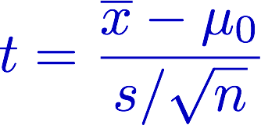
Hypothesis testing: step 2
Specify the test statistic which will be used to measure the departure from the H₀ : µ = µ₀, the value specified in the problem
For hypothesis tests on the sample mean the test statistic is:
Measures how far µ₀ is from x̅ in some ‘natural’ unit, the size of the standard error
  The t-distribution, with df = n-1 describes the distribution of the test statistic if the null hypothesis is true

Slide 16
Hypothesis testing: step 3
Defining an exceptional outcome, one which has only a small chance of occurring randomly if the null hypothesis is true
The probability chosen is called the significance level of the test and is labelled α
  Conventionally α = 0.05 is chosen
Confidence level: 1 - α or 100(1 – α)%
  i.e. significance level 0.05 corresponds to confidence level 95%

Slide 17
Hypothesis testing: step 3 cont.
α = 0.05 gives cut-off values on the sampling distribution of t called critical values
Values of the test statistic t lying beyond the critical values imply rejecting the null hypothesis
For the tablets example df = 26 -1, corresponding to critical values of the t distribution ±2.06

Slide 18
Hypothesis testing: step 4
Calculate the test statistic and check whether it lies in the critical region
For the example
t = −4.683 i.e. < −2.06 ∴ the hypothesis that the batch potency is 500 mg/tablet is rejected

Slide 19
p Values
The p value associated with a hypothesis test is the probability of getting sample values as or more extreme than those actually observed, assuming the null hypothesis is true
p = probability of observing a more extreme value
For the observed t = -4.683, p is the probability of being outside of ±4.683
It is the area of the t distribution below -4.683 and above +4.683
  0.00008474
There is a less than 1 in 10000 chance to observe t = -4.683 if the null hypothesis is true
The evidence for the alternative hypothesis is very strong

Slide 20
Two-tail and one-tail tests
Previous example was a two-tail test
Hypothesis rejected for either unusually large or small values of the test statistic
  The tails of the distribution at high and low values
One-tail test, can be either of
  Reject the hypothesis if the observed value of the test statistic is too large
  or
  Reject the hypothesis if the observed value of the test statistic is too small
In either cases the rejected values lie only in one tail (high or low)

Slide 21
Two sample inference
So far, we dealt with cases of a single population and single sample
Many studies require the characteristics of two populations to be compared
  Two samples are needed, one for each population
The two samples may be independent or dependent, depending on the way they are selected

Slide 22
Example
Test the connectivity of two new designs of mobile phone chips
Two independent samples: select sample of phones with chip 1 and another sample of phones with chip 2
Two paired samples: select pairs of identical model phones and use one of each pair for chip 1 and chip 2

Slide 23
Two-sample t-test
Consider inferences on two independent samples
We are interested in testing whether a difference exists in the population means, µ₁ and µ₂
Formulate hypothesis:
  H₀: µ₁ - µ₂ = 0
  H_{A}: µ₁ - µ₂ ≠ 0

Slide 24
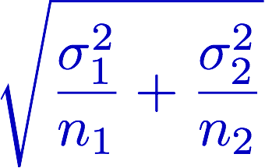
Two-sample t-test
A good choice is to consider the statistic x̅₂-x̅₁ and its sampling distribution
This will be centred at µ₂-µ₁,
with standard error
If the two populations are normal, the sampling distribution is normal
For large sample sizes (n₁ and n₂ > 30), the sampling distribution is approximately normal even if the two populations are not normal
  Follows from the Central Limit Theorem

Slide 25
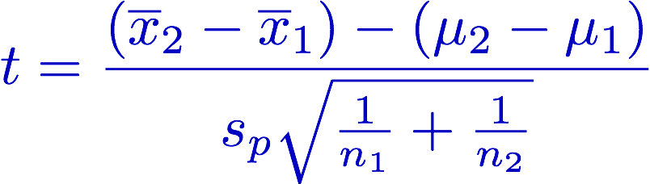
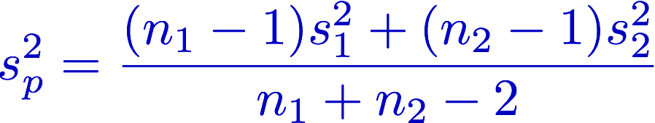
Two-sample t-test cont.
The two-sample t-statistic is defined as:
where
The two sample standard deviations are combined to give a
pooled estimate of the population standard deviation, σ

Slide 26
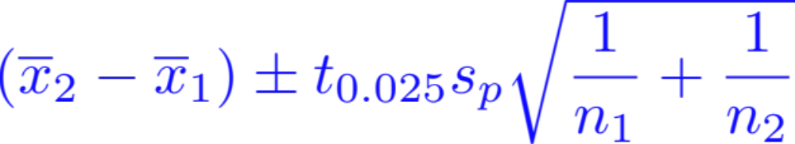
Two-sample t-test cont.
The t statistic has n₁ + n₂ – 2 degrees of freedom
Calculate critical values and the p value in the usual way
The 95% confidence level for µ₂ – µ₁ is

Slide 27
Example
Population | n | mean | s
Chip 1 | 20 | 35.9 | 11.9
Chip 2 | 38 | 36.6 | 12.3

Slide 28
Example cont.
Two-tailed test with 56 df and α = 0.05 therefore we reject the null hypothesis if t > 2 or t < -2
Fail to reject
  there is insufficient evidence of a difference in mean between the two chip populations
Confidence interval is -7.42 to 6.02

Slide 29
Paired t-test
Methods for independent samples are not appropriate for paired data
Consider the case of two related observations, e.g. two observations per subject, and you want to see whether the means of these two normally distributed variables differ from one another
Calculation of the t-statistic, 95% confidence intervals for the mean difference and p-values are estimated as for one-sample testing

Slide 30
Example
Patient | Before | After | Difference
1 | 62 | 59 | 3
2 | 62 | 60 | 2
3 | 65 | 63 | 2
4 | 88 | 78 | 10
5 | 76 | 75 | 1
6 | 57 | 58 | -1
7 | 60 | 60 | 0
8 | 59 | 52 | 7
9 | 54 | 52 | 2
10 | 68 | 65 | 3
11 | 65 | 66 | -1
12 | 63 | 59 | 4
13 | 60 | 58 | 2
14 | 56 | 55 | 1
14 patients were placed on a special diet to lose weight. Their weights were recorded before starting the diet and after one month
Question: Do the data provide evidence that the diet is effective?

Slide 31
Example
H₀ : µ_{d} = 0 (Mean of the difference values is zero)
H_{a} : µ_{d} > 0
x̅_{d} = 2.5 s_{d} = 2.98 n=14
t = 2.5/(2.98 / √14) = 3.14

Slide 32
Example
Critical Region (1-tailed) t > 1.771
Reject H₀ in favour of H_{a}
p value is the area to the right of 3.14 = 1 – 0.9961 = 0.0039
95% Confidence interval for µ_{d} = µ₂ – µ₁

Slide 33
Paired data – incorrect analysis
Suppose the data were incorrectly analysed as independent data samples
We would find t = 0.8
This is an upper-tailed test with 14 + 14 – 2 = 26 df and α = 0.05 (5% significance level), therefore H₀ is rejected if t > 1.706
Fail to reject – there is not sufficient evidence of a difference in the mean between the before and after weights

Slide 34
Wrong conclusions
Ignoring the paired structure of the data, we incorrectly concluded that there was no evidence for the effectiveness of the diet
When pairing is ignored the variability is inflated by subject-to-subject variation
The (correct) paired analysis eliminates this source of variability from the calculations, whereas the (incorrect) unpaired analysis includes it
You need to use the right test for the type of data

Slide 35

Summary
Methods for combining population data
Hypothesis testing
  Single population
  Two sample inference
  Paired data

